Slide 1
STAT3953 Group Project
Jackson Leung
Elizabeth Zhu
Kelvin Cheung
Natalie Fung
Tiffany Wong

Slide 2
Product Design
Product Features
Target Markets
Marketing Strategies
Pricing Model
Cash Flow Model
Assumptions
Financial Analysis
Sensitivity Analysis
Possible Policy Variation
Introduction & Background Research

Slide 3
Objective
Who are we? new management team of affinity insurance
Develop new product to diversify Affinity Insurance’s business portfolio
Provide proposal to the shareholders of Affinity Insurance

Slide 4
Marriversary
1st Endowment Marriage Product in HK

Slide 5
HK Divorce Trend 2001-2019
60%
Causes:
Increasing financial insecurity in HK
Evolving modern values towards marriage and individual liberty in HK society
From Census and Statistics Department of HKSAR Government

Slide 6
Market Consideration
Proliferation of divorce
Need for marriage prolongation
Demand for divorce protection
Sustain long-lasting relationship
Safeguard interests
(especially spouse who has weaker financial status)

Slide 7
Marriversary 1st Endowment Marriage Product in HK
Marriversary provides contingent benefits to meet couples’ needs in the courses of marriage and divorce
Divorce Protection
Anniversary Gift
Client purchases Marriversary for his/her spouse
Spouse receives benefit upon maturity/divorce/death

Slide 8

Product Highlights
First and only marriage endowment product
Protect against divorce and mortality risks
No-fault situation when couples divorce
Saving component encourage happy marriage
Flexible options on sum assured and maturity year

Slide 9
Product Positioning
Internal Positioning
New product line
External Positioning
First to market
No cannibalization of existing products
Gain large market share

Slide 10
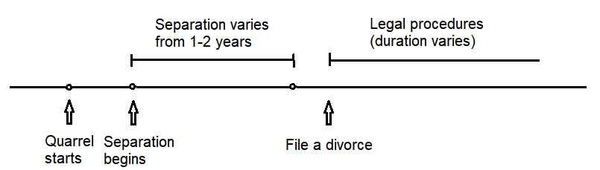
Legal Process for Divorce
Under HKSAR Marriage Law:
If both agree to divorce: at least 1 year of separation before filing a divorce; or
If only one party wishes to divorce: at least 2 years of separation before filing a divorce
Hong Kong e-Legislation, “Cap.192 Matrimonial Proceedings and Property Ordinance,” & “Cap. 179 Matrimonial Causes Ordinance,”
Notes:
Before we look into the product features…
A proof of adultery of either party; or
A proof that either party has behaved in such a way that it cannot be reasonably expected to live with together.

Slide 11
Legal Disputes during Divorce
50:50 distribution of assets
Request alimony (贍養費): lump sum or monthly payment
Marriversary can provide a no-fault divorce
Lowering cost by avoiding expensive litigation incurred by divorce
Problem during recovery process:
Alimony arrears
Late and insufficient alimony
Be scold or humiliated when collecting alimony
Ex-husband went missing
From results of Questionnaire regarding divorced women’s status of recognition of alimony in 2016, the Hong Kong Federation of Women’s Centres.
Notes:
During divorce process, the couples will face various legal disputes

Slide 12





Product Features
Who are the policyholders?
Payer
Beneficiary
What benefits do we provide?
Maturity Benefit
Divorce Benefit
Death Benefit
How to avoid adverse selection?
3-year Elimination Period
Linearly increasing sum assured
Highlight
3-year grace period
Notes:
MMMMM
Breadwinner, nonbreadwinner
Divorce generally is filed within 3 years
(moral hazard: difficult, life-like, alternative is cap to certain multiple of salary)

Slide 13
Product Features
Sum Assured | Minimum: HK$100,000 Maximum: HK$3,000,000
Issue Age | Age 18 - 50 | Age 18 - 45 | Age 18 - 40
Policy Term | 15 | 20 | 25
Premium Payment Term | 12-pay | 17-pay | 20-pay
Premium Payment Mode | Annual or monthly
Premium Structure | Level and guaranteed Varies by plan, issue ages, genders, smoking status of both payer and beneficiary Waived for 3 years upon indication of divorce
Notes:
MMMMM
3 years: due to grace period
22 -> 20 because we want to increase customer yield

Slide 14
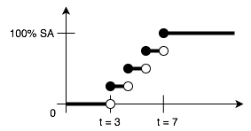
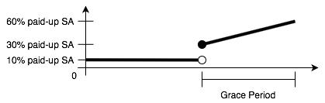
Product Features - Benefits
Maturity Benefit | 100% of SA
Divorce Benefit
Death Benefit | Case 1: Only beneficiary dies |  | ROP to payer
 | Case 2: Only payer dies |  | 100% of SA
 | Case 3: Both dies within a policy month |  | 100% of SA
Surrender Charge |  |  | 10% of paid-up SA
Surrender Benefit | Before 3rd policy anniversary | None
 | After 3rd policy anniversary | Paid-up policy with reduced and unguaranteed SA less surrender charge
Notes:
MMMMM

Slide 15
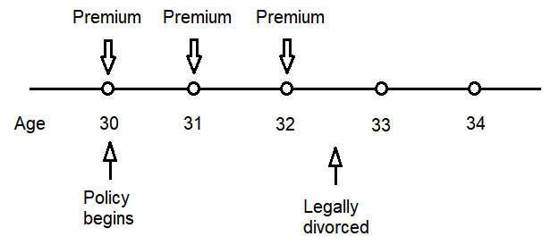
Case Study 1
Mr. Chan bought Marriversary at age 28.
2 years later, they file for a divorce
 Divorce during elimination period
 No benefit will be paid

Slide 16
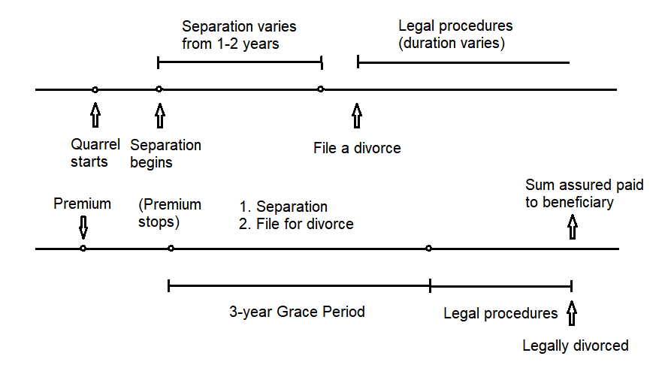
3-Year Grace Period
Notes:
Payer need not pay premium during separation
Beneficiary can receive full SA, payer need not turn it into paid-up policy

Slide 17
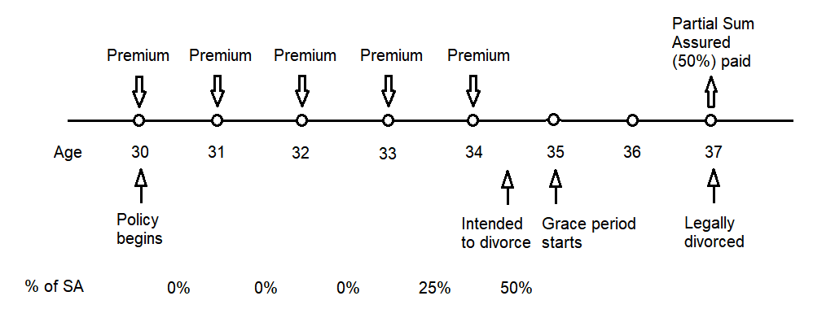
Case Study 2
Mr. Lee bought Marriversary at age 30, SA is HK$1,000,000.

Slide 18
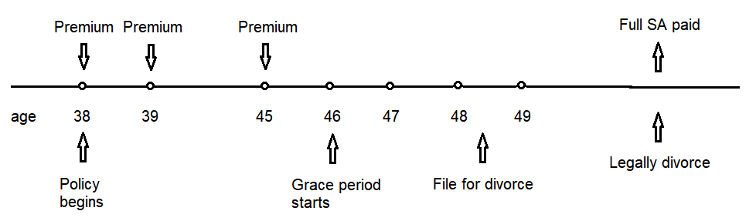
Case Study 3
Mr. Wong bought Marriversary at age 38.

Slide 19

Target Markets
Pre-wed and Married couples
Different financial status
Couples who are going through stages of life that may diminish partner’s earning ability
Notes:
Limitation
Our high annual premium along with the reducing marriage rate may limit access to the mass market.
Mass affluent Pre-wed and Married couples with possible imbalance in earning abilities and financial status
Couples who are going through stages of life that may diminish partner’s earning ability, such as giving birth, becoming a housewife or househusband, and etc

Slide 20
Characteristics of Marriversary in the view of Pre-wed and married couples
Target Market
Mass affluent Pre-wed and Married couples with possible imbalance in earning abilities and financial status
Couples who are going through stages of life that may diminish partner’s earning ability, such as giving birth, becoming a housewife or househusband, and etc
Limitations
Our high annual premium along with the reducing marriage rate may limit access to the mass market.
Extend protection for beneficiary after premium payment ceased
When the couples are considering a divorce, the beneficiary may be put in a very vulnerable position, because he or she cannot force the payer to continue paying the premiums.
A 3-year Grace Period ensures the beneficiary’s benefits would not be undermined when relationship starts deterring before the actual legal divorce.
Beneficiary makes decisions
Modification to the policy, such as surrendering the policy before entering the Grace Period, is decided by the beneficiary. Such arrangement provides an additional sense of security to the beneficiary and avoids bad-faith decisions made by the payer.
Saving component encourages customers who underestimate chance of divorce to pay and save for marriage protection.
Life protection provides a safety net if the beneficiary losses his or her source of income due to the death of the payer.
Return of premium ensures the premium payments would not be forfeited when the protection is ultimately not needed.
Level premium provides guarantees and easy financial planning. It is a must-have.
Characteristic of Marriversary

Slide 21

Characteristics of Marriversary in the view of Pre-wed and married couples
Extend protection for beneficiary after premium payment ceased
Beneficiary makes decisions
Saving component
Life protection
Return of premium
Level premium
Notes:
Extend protection for beneficiary after premium payment ceased
When the couples are considering a divorce, the beneficiary may be put in a very vulnerable position, because he or she cannot force the payer to continue paying the premiums. A 3-year Grace Period ensures the beneficiary’s benefits would not be undermined when relationship starts deterring before the actual legal divorce.
Beneficiary makes decisions
Such arrangement provides an additional sense of security to the beneficiary and avoids bad-faith decisions made by the payer.
Modification to the policy, such as surrendering the policy before entering the Grace Period, is decided by the beneficiary.
Saving component encourages customers who underestimate chance of divorce to pay and save for marriage protection.
Life protection provides a safety net if the beneficiary losses his or her source of income due to the death of the payer.
Return of premium ensures the premium payments would not be forfeited when the protection is ultimately not needed.
Level premium provides guarantees and easy financial planning. It is a must-have.

Slide 22

Marketing Strategies
Partnering with wedding planners
Advertisement on public transports
Social media pages
Promotional emails
Through agents

Slide 23

Distribution Channel
Brokers
Direct agents
Online purchase

Slide 24
Commission Rates
Initial Commission Rate | 30% of the first premium
Trailing Commission Expense | 5% of future renewals

Slide 25
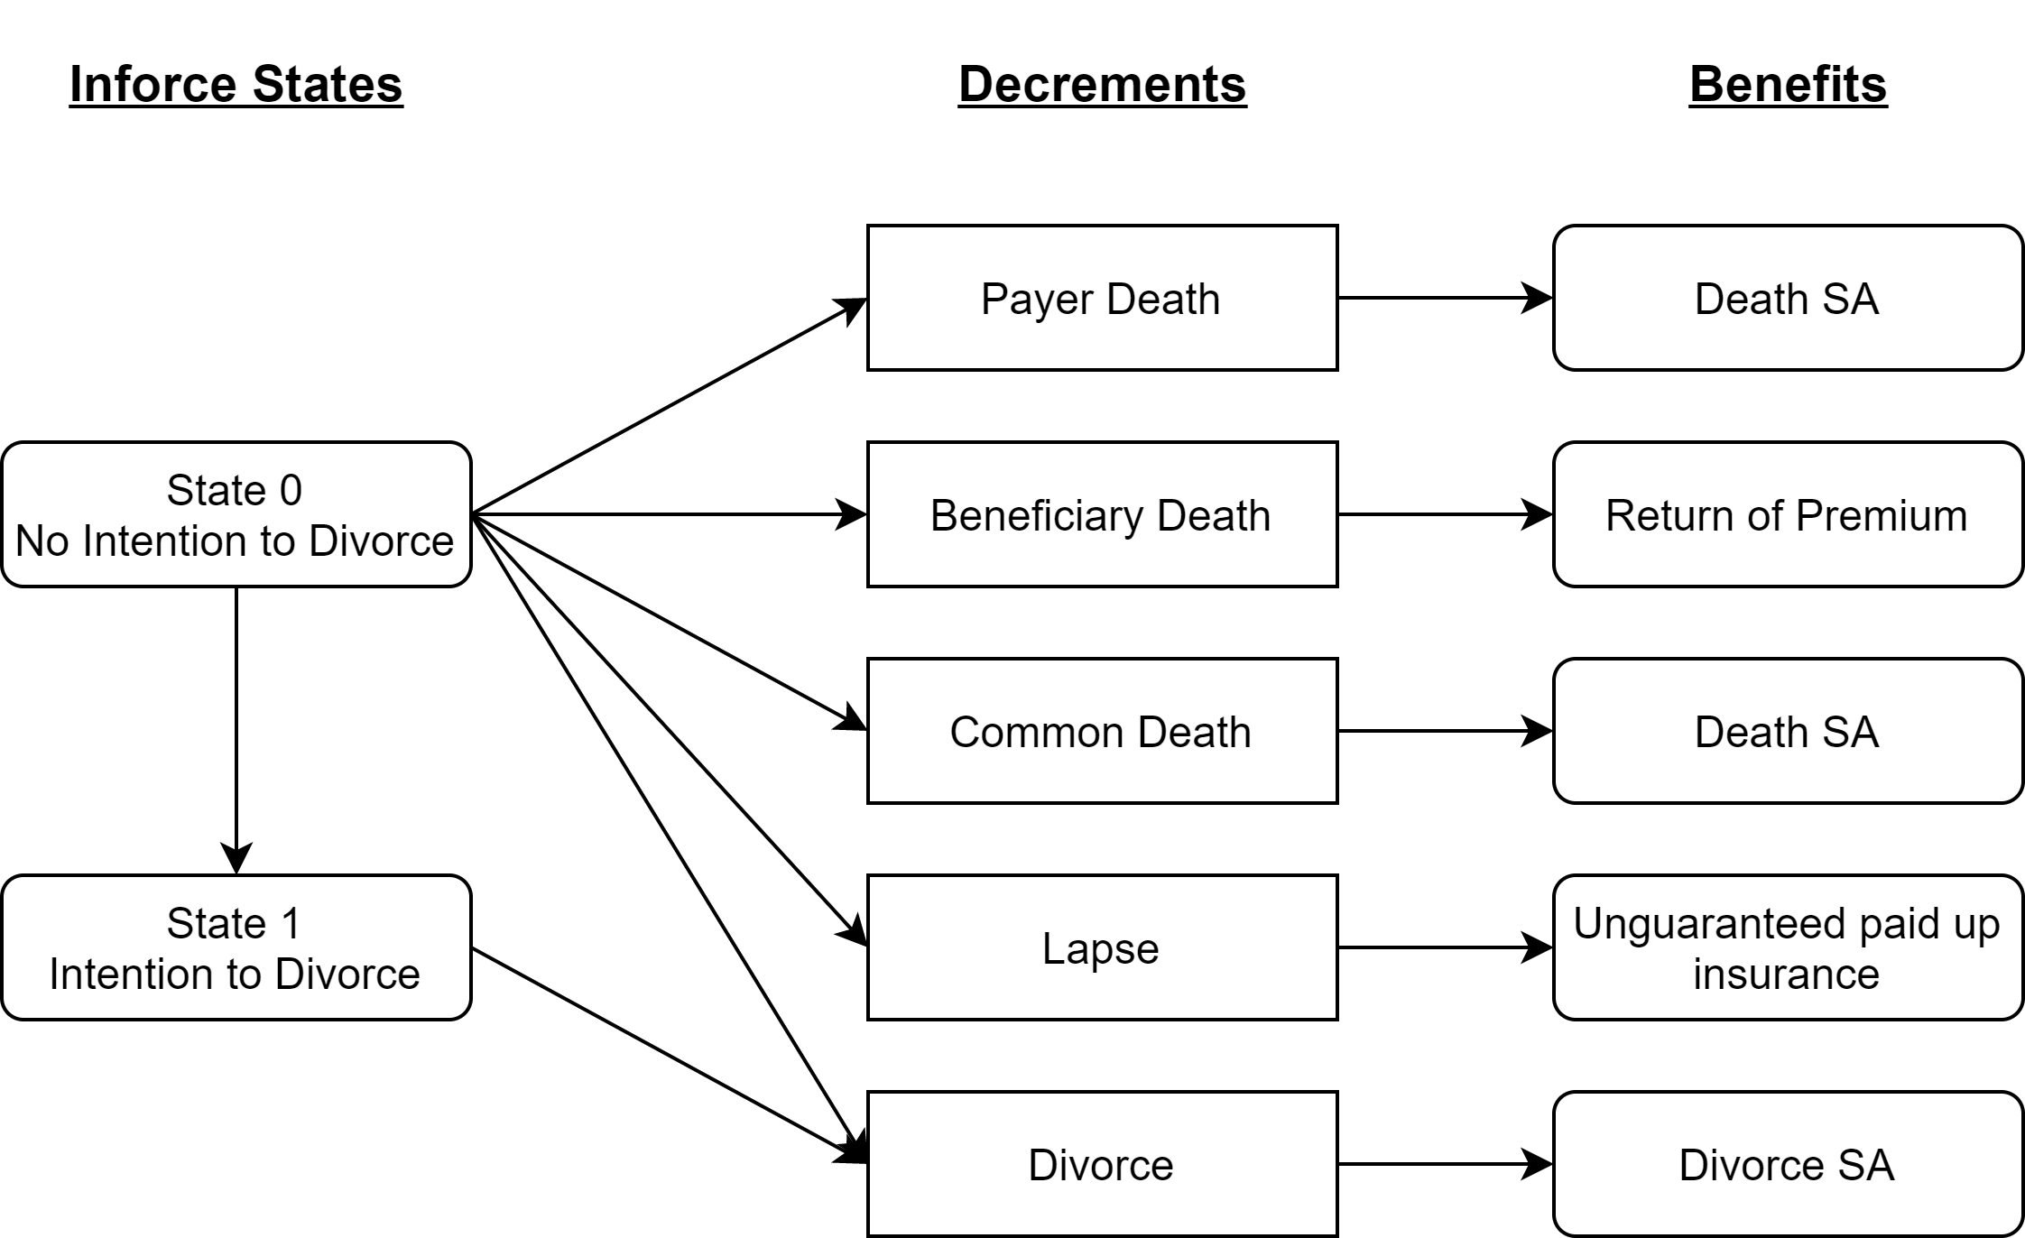
Multi-State Cash Flow Model
Notes:
5 Decrements and corresponding benefits
2 inforce states
Simplified model
Benefit other than divorce only consist of less than 5% of benefit outgo
Semi-Markov Process
State 1 prob depends on when enter the state
Implemented using 4 decrement table

Slide 26
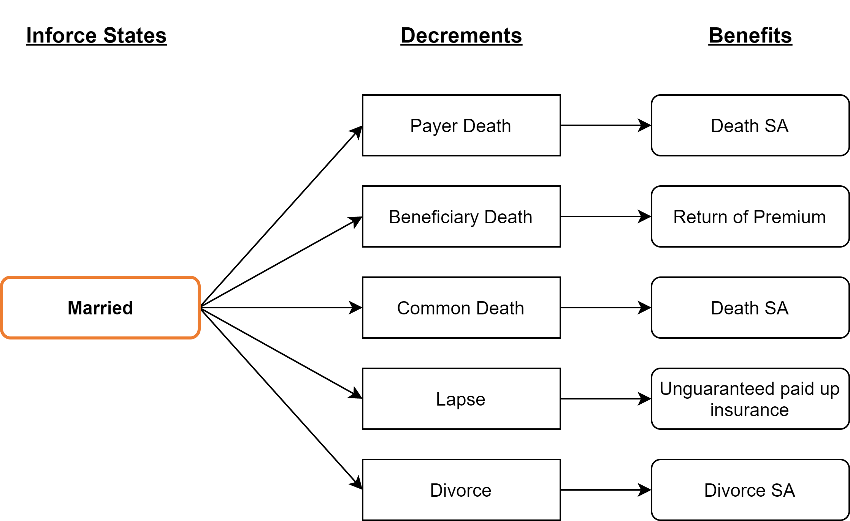
Population Decrement Table
Multiple decrement model
SUDD assumption
Notes:
Diagram for our population decrement model
For a general married person, probability for them to enter each decrement
Model the table using Multiple decrement model and SUDD assumption

Slide 27
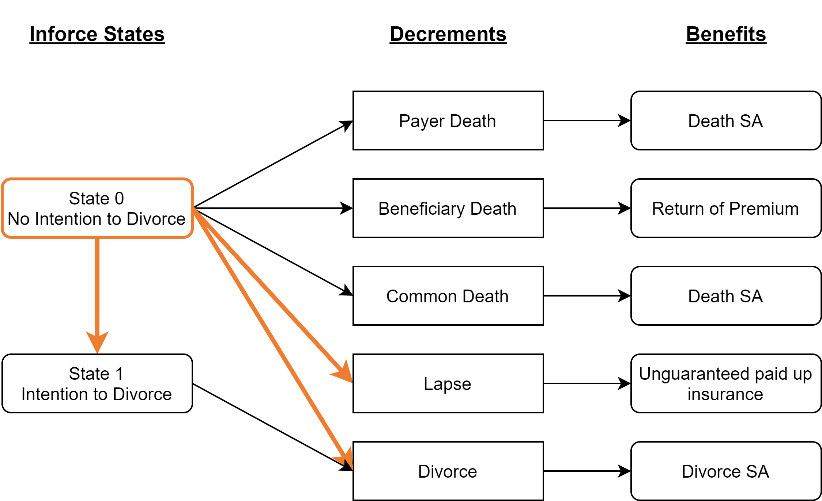
State 0 Decrement Table
Lapse during elimination period
Enter grace period
Notes:
State 0 In-force shows people that are paying premium with no intention to divorce
Ways to transit out of state 0
If stop paying premium during first 3 years, lapse instead of divorce
Transition prob by weight average of the divorce rate of the next 3 years

Slide 28
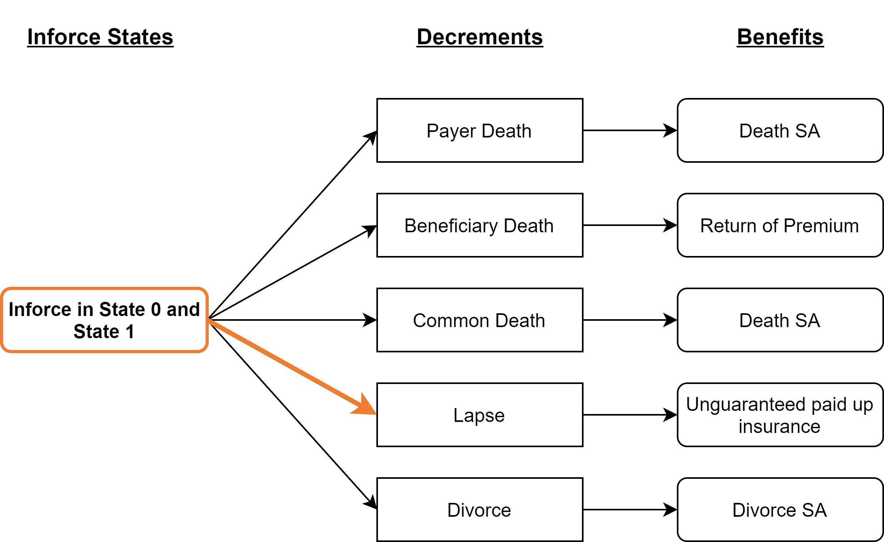
Policy Decrement Table
Lapse include policy entering grace period or divorce during elimination period
Notes:
Modification of population decrement table
Only difference => if stop paying premium during elimination period, become lapse
Inforce facor includes states 0 and 1

Slide 29
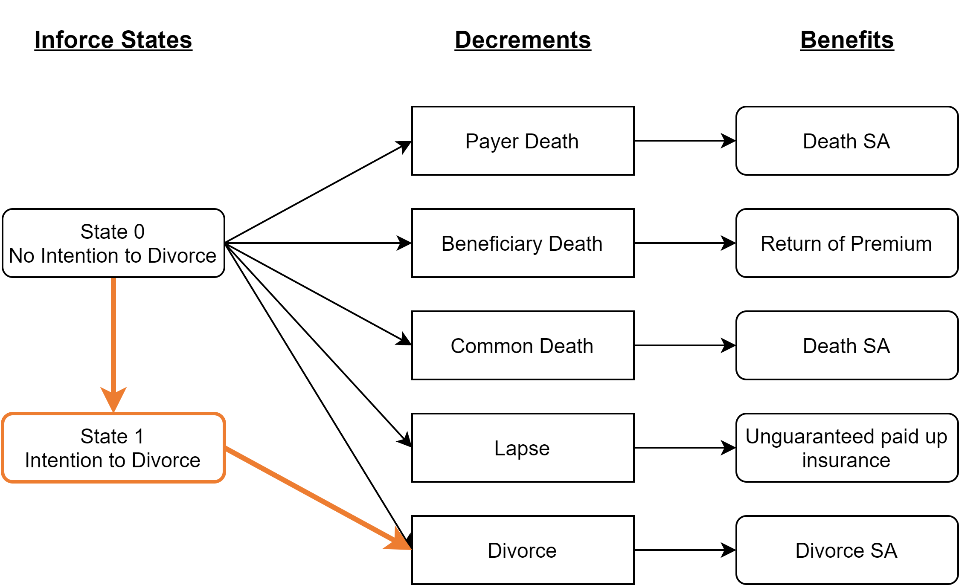
State 1 Decrement Table
Difference between Policy and State 0 tables
Notes:
IF factor do not show when the policy enter the state
Markov chain is used for approximation when calculating reserves
Reserves based on average of all policies in state 1

Slide 30

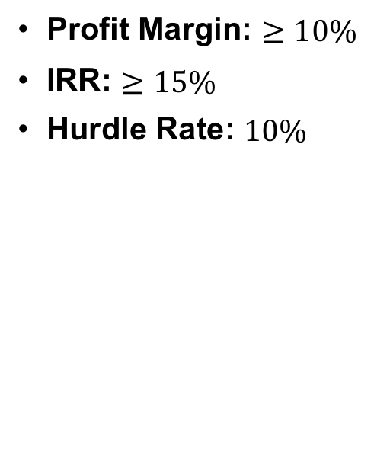
Pricing Assumptions
Profit Margin: $≥10\%$
IRR: $≥15\%$
Hurdle Rate: $10\%$
Notes:
MMMMM
We have set these pricing assumptions, for

Slide 31




Pricing Assumptions -- Divorce Assumption
&
Averaging method to merge male rates and female rates
High correlation between ages of couples
Bicubic interpolation and extrapolation, floored by minimum group rate
Time between having divorce intention and divorce filing completion is uniformly distributed from 0 – 3 years
Divorce rates by age group
Married population
Divorce cases
Notes:
MMMMM
*male rate table female rate table*
*by age group*
Weighted average,

Slide 32
Pricing Assumptions -- Overview
Mortality |  | Hong Kong Assured Lives Mortality Table (HKA18) - With 169% adjustment on smoker’s mortality
Lapse |  | 0%
Expense | Initial | 8% of premium
 | Maintenance | 5% of premium
 | Settlement | $2 per $1000 SA
Economic | Rate of Return | 5.4648%
 | Expected Inflation Rate | 3%
 | Corporate Tax Rate | 16.5%
Notes:
MMMMM

Slide 33
Reserve Assumptions -- Overview
Liabilities
Gross Premium Valuation (GPV)
Risk margin for insurance and economic risks
Provision for Adverse Deviation (PAD) using Hong Kong Risk Based Capital (HKRBC)
Mortality | Payer | +15%
 | Beneficiary | -25%
Divorce |  | +30%
Lapse |  | -40%
Expense |  | +10% for all years +1% additive in expense inflation
Economic | Interest Rate | -25%
Notes:
MMMMM

Slide 34
Business Mix for Profitability Projection

Slide 35
Business Mix for Profitability Projection
Sales Volume By Issue Age Mix
 |  | Age of Male
 |  | 18 | 22 | 27 | 32 | 37 | 42
Age of Female | 18 | 0.2% | 0.7% | 0.3% | 0.1% | - | -
 | 22 | 0.2% | 5.6% | 6.4% | 2.2% | 0.6% | 0.3%
 | 27 | - | 1.9% | 21.5% | 14.5% | 3.5% | 1.3%
 | 32 | - | 0.2% | 3.7% | 16.6% | 6.3% | 2.3%
 | 37 | - | - | 0.4% | 1.8% | 3.4% | 2.4%
 | 42 | - | - | 0.1% | 0.3% | 0.5% | 2.5%

Slide 36
Business Mix for Profitability Projection
By Maturity Year
Maturity Year | Total Sales Volume
15 | 15%
20 | 35%
25 | 50%
By Payment Mode
Maturity Year | Annual | Monthly
15 | 30% | 70%
20 | 50% | 50%
25 | 70% | 30%

Slide 37
Monitoring Experience
Mortality
currently assumes lives are independent
Divorce rate
need to reconcile with 2021 census
focus on in-house divorce experience in future
Current assumption:
Static and independent from marriage length
No skewness factor in divorce progress
Interest rate
re-pricing when necessary
 | Experience studies to be performed
Mortality | At least every 3 years
Divorce rate | At least every 3 years
Interest rate | On regular basis by investment team
Notes:
The experience for divorce rate will only emerged after 3 years, so our first experience study for divorce rate need to be reconciled with 2021 census
Then in the future, we can focus more on in-house…
Divorce progress is currently uniform

Slide 38
Profitability Metrics & Premium Split
 | Total
Profit margin | 10.08%
NBV per AP | 76.25%
NB strain | 22.82%
Discounted payback period | 2.42
Notes:
Profit margin: consistent with our pricing target
DPP: short period because of 3-yr elimination period

Slide 39
Reserve Pattern
Notes:
Increases stepwise, because premiums are paid every year, increases continuously after premium stops.
Red curve, interest risk charge, which is relatively small

Slide 40
Net Asset at Risk (NAAR)
Notes:
Death NAAR: decreases as policy ages
Divorce NAAR: stays 0 in first 3 years, increases stepwise, reaches max in 7th year
ROP NAAR: small, add trivial amount of risk to the product

Slide 41
Divorce risk and interest rate risk are the key risks to profitability
-1.3%
Divorce Rate +20%
-1.3%
Notes:
We have run sensitivity test on numerous risks, table too large, too bulky
Divorce Risk: More people divorce, pay more benefits coz company pays 100% SA
Shorter/ Longer time to divorce:
When the couple starts the divorce progress, they enter grace period and stop paying premium, the longer it takes for divorce to be completed/ the earlier they enter the grace period, the lower the profit margin.
Interest rate risk: Marriversary is an endowment product which is higher affected by fluctuations of interest rates.
When interest rate decreases, investment earning decreases.
Mortality Risk
less than 0.2% fluctuation in profit
This is a saving oriented product with limited mortality exposure under a short policy term.
Mortality of payer will create a more slightly more negative impact on our profit margin
Payer die => pay 100% SA
Beneficiary = return of premium << maturity benefit : more profitable if beneficiary die faster
Lapse Risk
Marriversary is lapse-supported. Higher lapse rate increases the profit margin.

Slide 42
Sensitivity Test & Risk Analysis
 | Financials |  |  |  | Variance from Base
 | 15-mature | 20-mature | 25-mature | Total | 15-mature | 20-mature | 25-mature | Total
Profit Margin
Base | 10.1% | 10.1% | 10.1% | 10.1%
Payer Mortality * 120% | 10.0% | 10.0% | 9.8% | 10.0% | -0.1% | -0.1% | -0.2% | -0.1%
Beneficiary Mortality * 80% | 10.1% | 10.1% | 10.1% | 10.1% | 0.0% | 0.0% | 0.0% | 0.0%
Beneficiary Mortality * 120% | 10.1% | 10.1% | 10.0% | 10.1% | 0.0% | 0.0% | 0.0% | 0.0%
Divorce * 120% | 9.6% | 8.7% | 8.0% | 8.8% | -0.5% | -1.4% | -2.1% | -1.3%
Divorce * 200% | 8.0% | 3.6% | 0.1% | 3.9% | -2.1% | -6.5% | -9.9% | -6.2%
Divorce Trend: Rate + 1% per year (multiplicative) | 9.9% | 9.4% | 9.0% | 9.4% | -0.2% | -0.7% | -1.1% | -0.7%
Divorce Trend: Rate + 3.9% per year (multiplicative) | 9.1% | 7.1% | 5.2% | 7.2% | -1.0% | -3.0% | -4.8% | -2.9%
Divorce Progress (all 1st month) | 14.0% | 15.3% | 15.9% | 15.1% | 3.9% | 5.2% | 5.8% | 5.0%
Divorce Progress (all 3 years) | 5.8% | 4.2% | 3.5% | 4.5% | -4.3% | -5.9% | -6.5% | -5.6%
Earn Rate -50bps | 7.9% | 7.5% | 7.1% | 7.5% | -2.2% | -2.6% | -2.9% | -2.6%
Earn Rate -100bps | 5.7% | 4.9% | 4.2% | 4.9% | -4.4% | -5.2% | -5.8% | -5.1%
Expense * 120% | 9.0% | 9.0% | 9.0% | 9.0% | -1.1% | -1.1% | -1.1% | -1.1%
Lapse + 0.1% for all years (additive) | 10.8% | 11.1% | 11.6% | 11.1% | 0.7% | 1.0% | 1.6% | 1.1%
NBV per AP
Base | 67.1% | 76.4% | 80.9% | 74.7%
Payer Mortality * 120% | 66.5% | 75.5% | 79.1% | 73.6% | -0.6% | -1.0% | -1.7% | -1.1%
Beneficiary Mortality * 80% | 67.2% | 76.5% | 81.0% | 74.8% | 0.1% | 0.1% | 0.1% | 0.1%
Beneficiary Mortality * 120% | 67.1% | 76.4% | 80.7% | 74.6% | -0.1% | -0.1% | -0.1% | -0.1%
Divorce * 120% | 63.0% | 64.5% | 62.5% | 63.5% | -4.1% | -12.0% | -18.4% | -11.2%
Divorce * 200% | 48.7% | 24.0% | 0.8% | 25.7% | -18.5% | -52.4% | -80.0% | -49.0%
Divorce Trend: Rate + 1% per year (multiplicative) | 65.4% | 70.9% | 71.6% | 69.3% | -1.7% | -5.6% | -9.2% | -5.3%
Divorce Trend: Rate + 3.9% per year (multiplicative) | 59.8% | 52.4% | 40.8% | 51.7% | -7.3% | -24.0% | -40.1% | -23.0%
Divorce Progress (all 1st month) | 92.3% | 114.8% | 126.4% | 110.8% | 25.2% | 38.3% | 45.6% | 36.1%
Divorce Progress (all 3 years) | 38.8% | 32.4% | 28.7% | 33.4% | -28.4% | -44.1% | -52.2% | -41.3%
Earn Rate -50bps | 52.5% | 56.9% | 57.4% | 55.7% | -14.6% | -19.5% | -23.4% | -19.0%
Earn Rate -100bps | 37.8% | 37.3% | 33.9% | 36.6% | -29.3% | -39.1% | -47.0% | -38.1%
Expense * 120% | 59.9% | 68.3% | 72.1% | 66.7% | -7.2% | -8.1% | -8.8% | -8.0%
Lapse + 0.1% for all years (additive) | 71.6% | 83.8% | 93.5% | 82.5% | 4.5% | 7.3% | 12.7% | 7.8%

Slide 43

Possible Policy Variation - Participation
Aggressive pricing assumptions and investment portfolio
Higher target customer yield rate
Unguaranteed dividends
Notes:
Increase equity from 30% to 50%
For 25-years-maturity policy, customer annual yield increase from 1.5% to 2.5%

Slide 44

Possible Policy Variation
Guaranteed cash payment
Variations in payment-term and maturity option
Guaranteed issue
Notes:
Consolidate saving element
More flexible
Low sensitivity on Mortality

Slide 45


Conclusion
First-to-market
Revolutionary marriage protection
Comprehensive multi-state model

